Slide 1
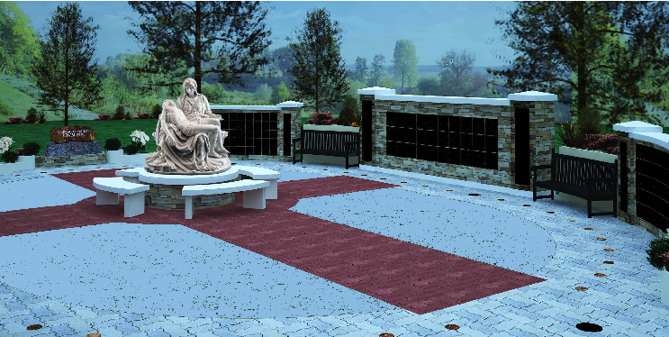
IC Columbarium and Prayer Garden
*Artist’s rendering – not exact representation
“I Am the Resurrection and the Life.” – John 11:21-27

Slide 2
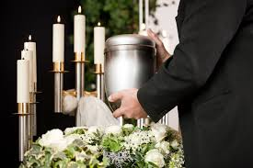
Did you know?
The Catholic Church has accepted cremation since 1963,
yet maintains ashes are to be treated with the same respect as corporal remains.

Slide 3
Did you know?
IC is 1 of 6 parishes within the Superior Diocese that either has, or is in the process of creating, a columbarium as an option for inurnment.
Immaculate Conception, Grantsburg – 2020
Our Lady of Lourdes, Dobie – 2020
St. Joseph, Hayward – 2019
Immaculate Conception, New Richmond – 2019
Our Lady of the Lakes, Ashland 2017
St. Patrick’s, Hudson - 2012

Slide 4
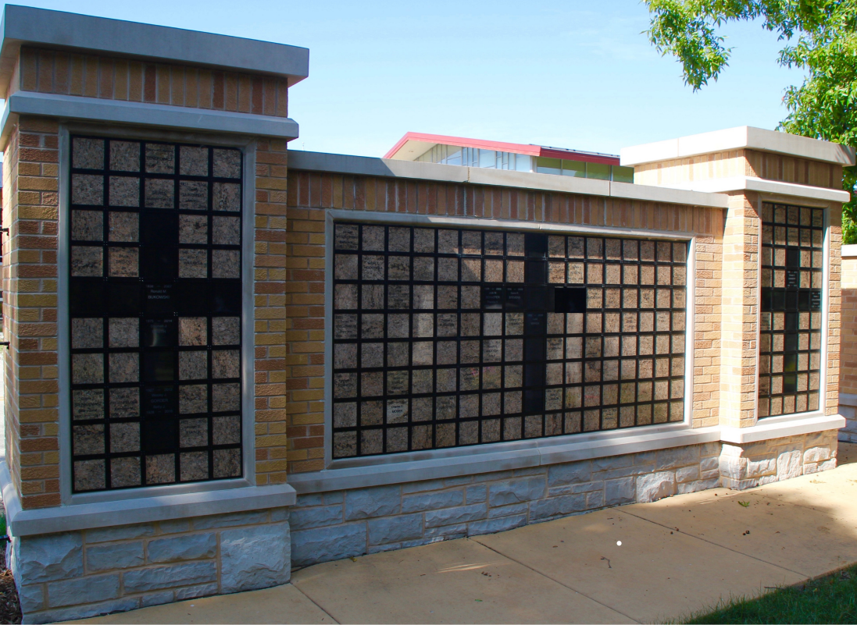
What is a Columbarium?
An above-ground structure
Designed to house cremains (person’s cremated remains)

Slide 5
What is a Columbarium?
System of niches, designed for maximum security
Niche = secured compartment, holds 1-2 urns
*Video credit: Architarium (https://youtu.be/wK2vhpa1UlI)

Slide 6
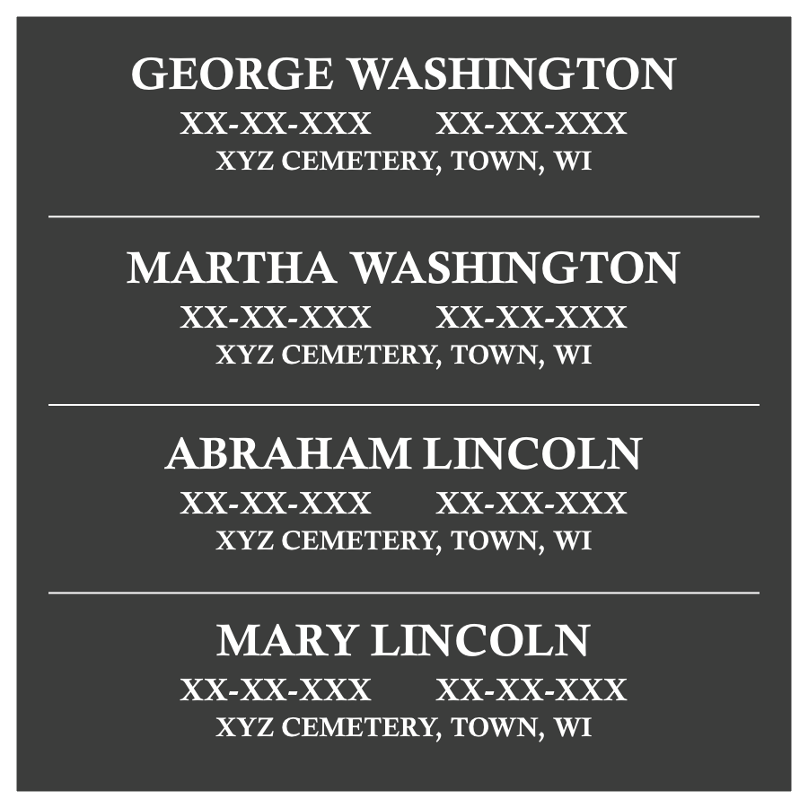
IC’s Memory Wall
Honor loved ones interred elsewhere
Inscription includes:
Name
DOB/DOD
Where the individual is laid to rest

Slide 7
Funding and Support
Donations
Niche Sales
Memory Wall Inscriptions
Memorials
Volunteer help – greatly reduces overall cost!
Local contractors – pledging to donate time
Prayers – warmly welcomed, for the success of this important community ministry

Slide 8
IC Columbarium Committee
Deacon Stan Marczak (Admin): marczak@grantsburgtelcom.net
Kerri Harter (Chair): 715-463-2461 – now@grantsburgtelcom.net
Stephanie Wickstrom (Recorder): 715-791-0391 - smjudd@yahoo.com
Dave Wibben (Fund-raising): 612-803-6384 – drwibben@gmail.com
Betty Peer (Fund-raising): 715-689-2940 - peersb1937@gmail.com
Shari Harter: 715-791-4839 - shariharter@hotmail.com

